Slide 1
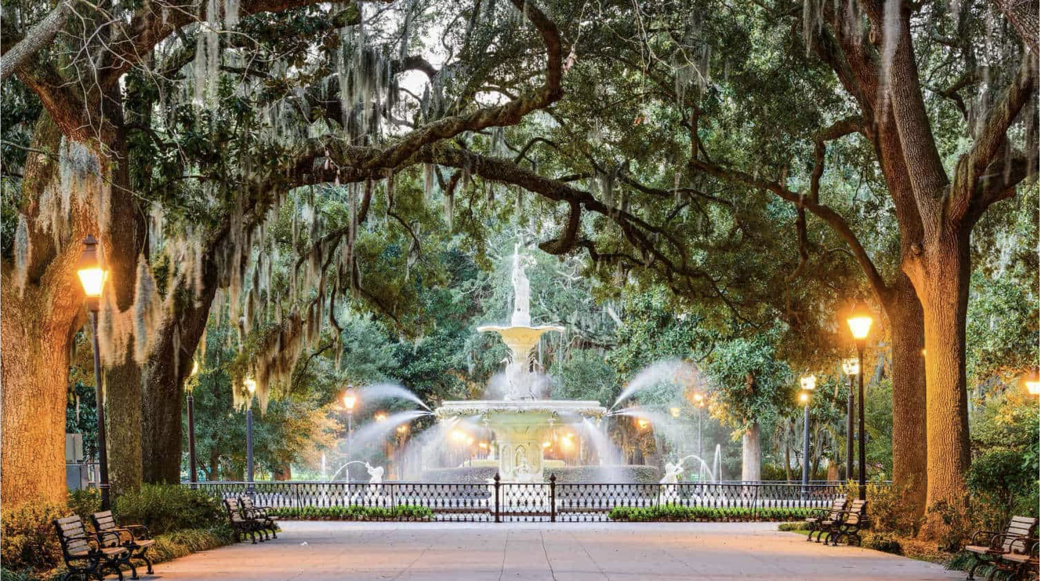


2025 EIPBN MicroGraph Contest
#1
PUT YOUR MICROGRAPH ROUGHLY HERE
BUT LOSE THIS BOX
MicroGraph Title: Pick something
that the judges will change
Description: The more details the
better.
Image Details:
Orig. Mag: (3”x 4” image): ???kX
Instrument: : Manufacturer, Type and
Model of Microscope
Submitted By: Your Name(S)
Affiliation: Your Institution
Sponsored by:

